Slide 1

R1
by: Michael Dandrea

Slide 2
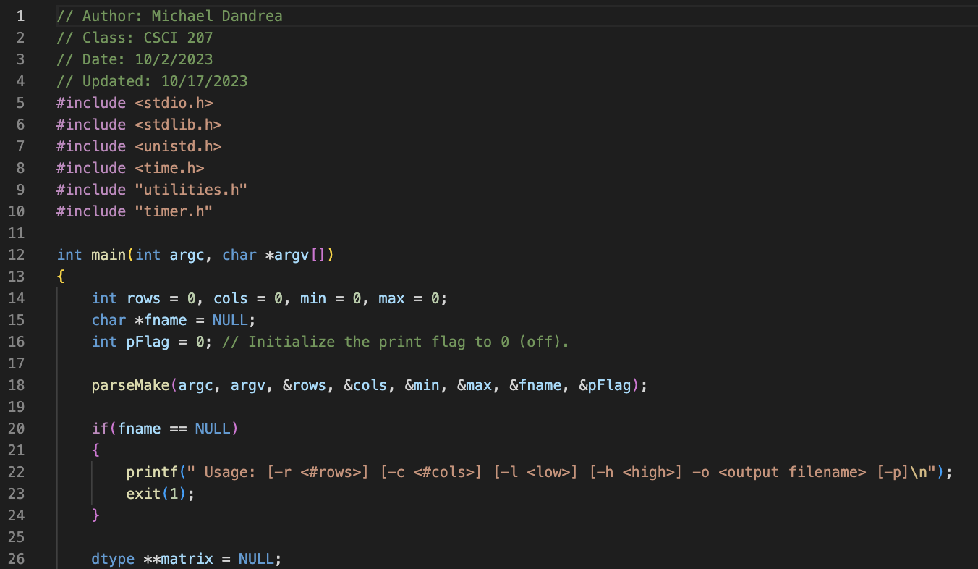
make_data_2d.c

Slide 3
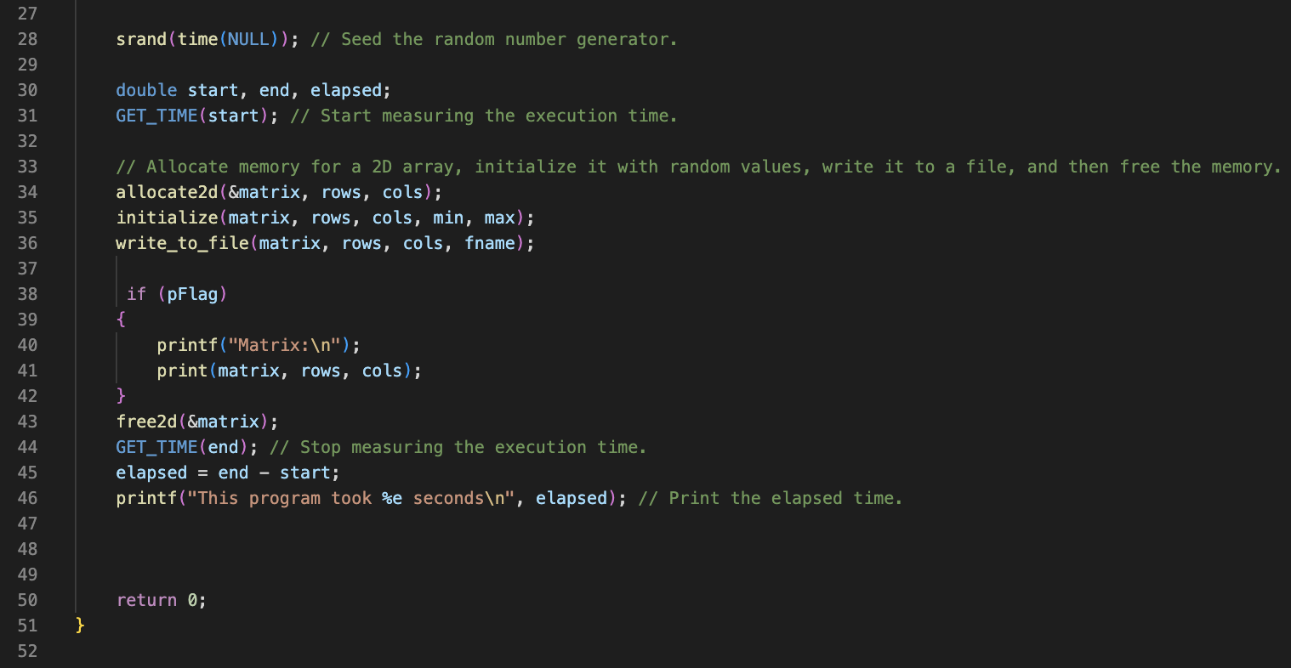
make_data_2d.c (cont.)

Slide 4
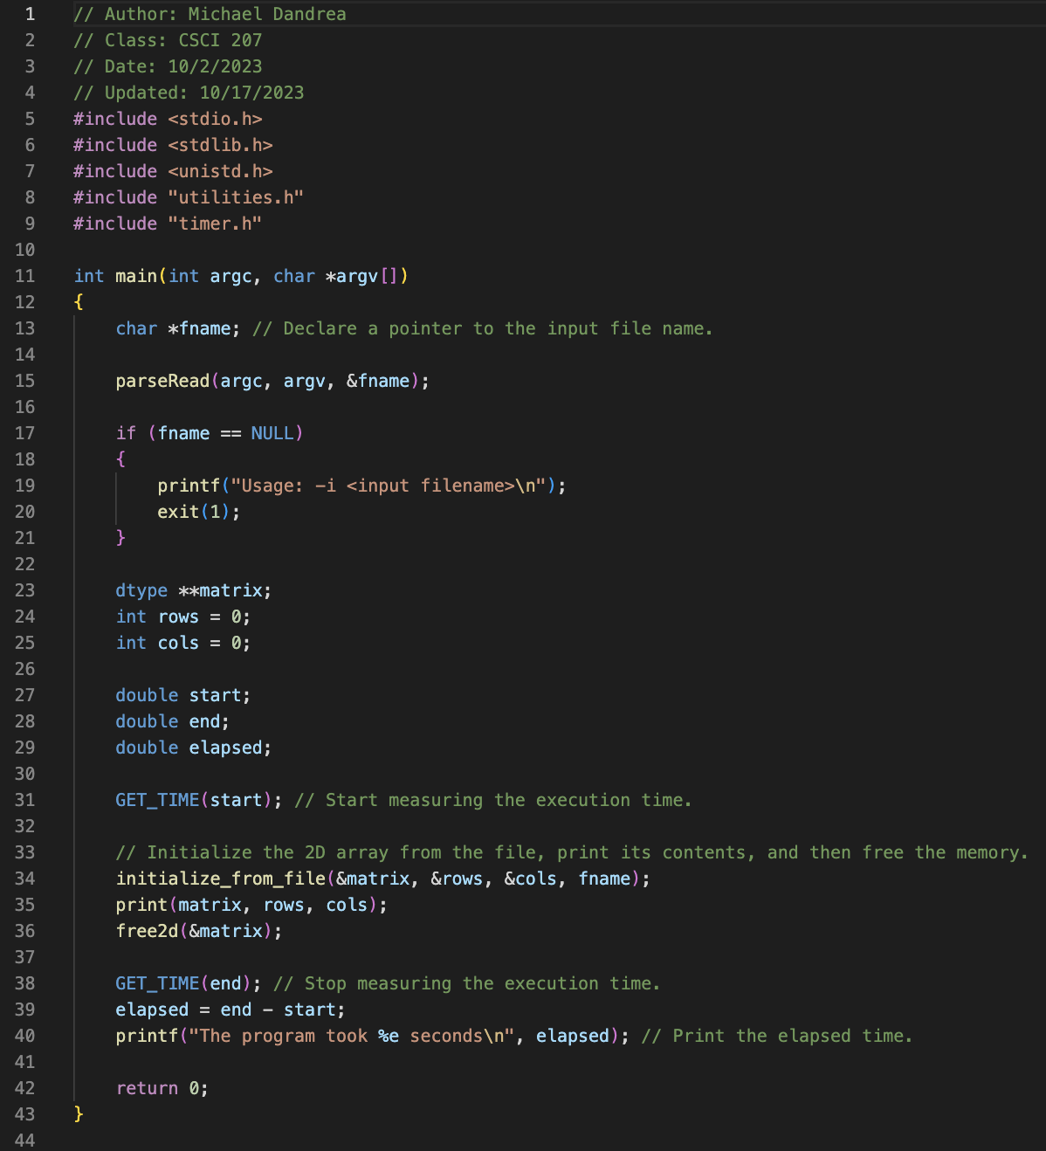
read_data_2d.c

Slide 5
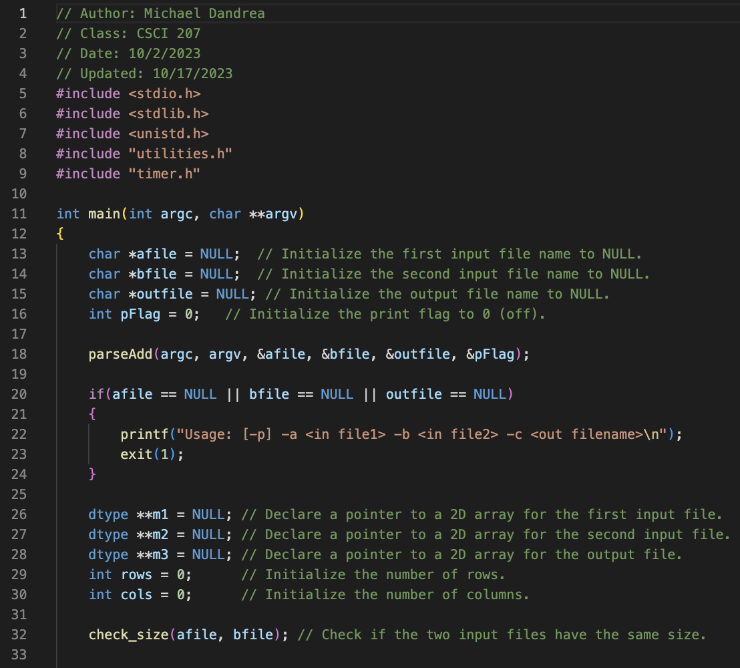
add_data_2d.c

Slide 6
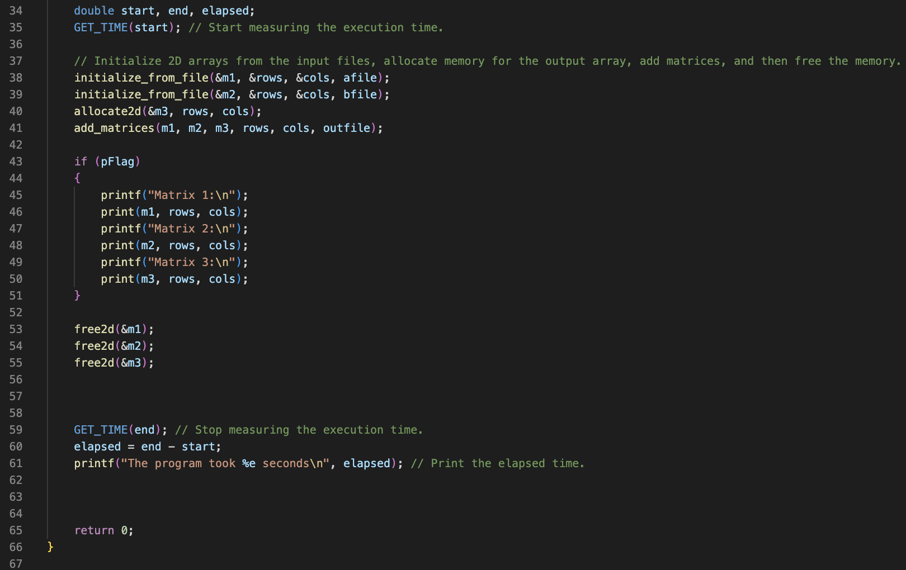
add_data_2d.c (cont.)

Slide 7
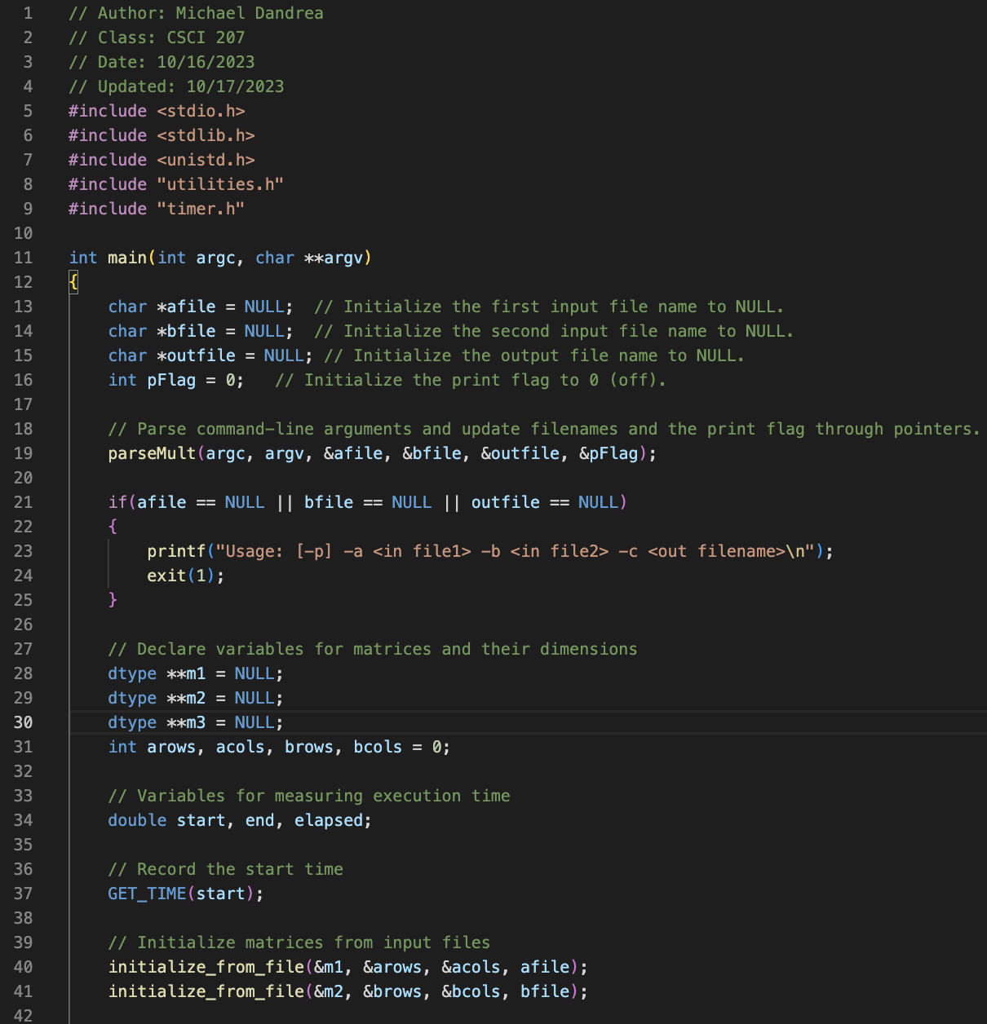
mul_data_2d.c

Slide 8
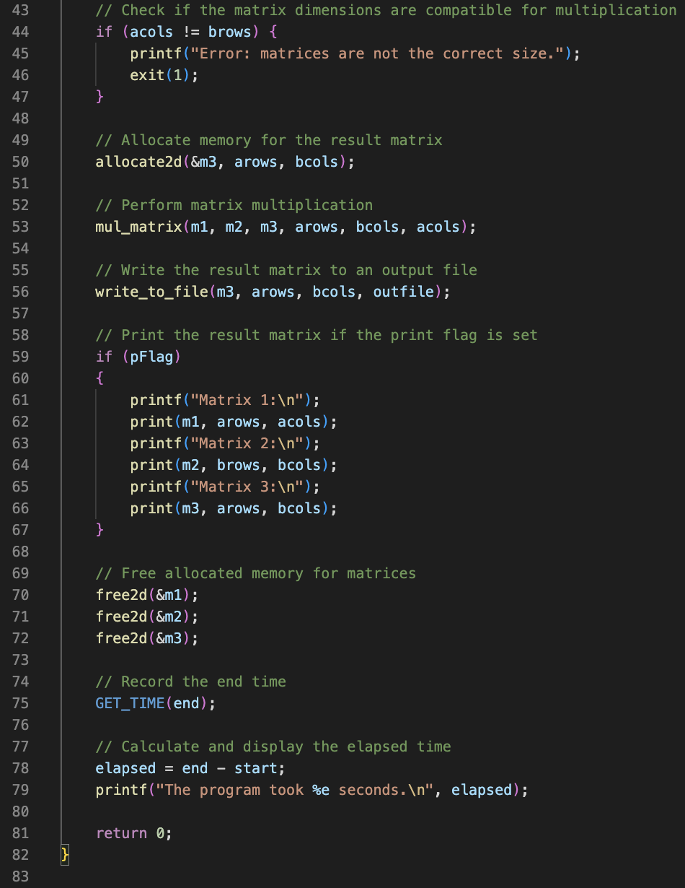
mul_data_2d.c (cont.)

Slide 9
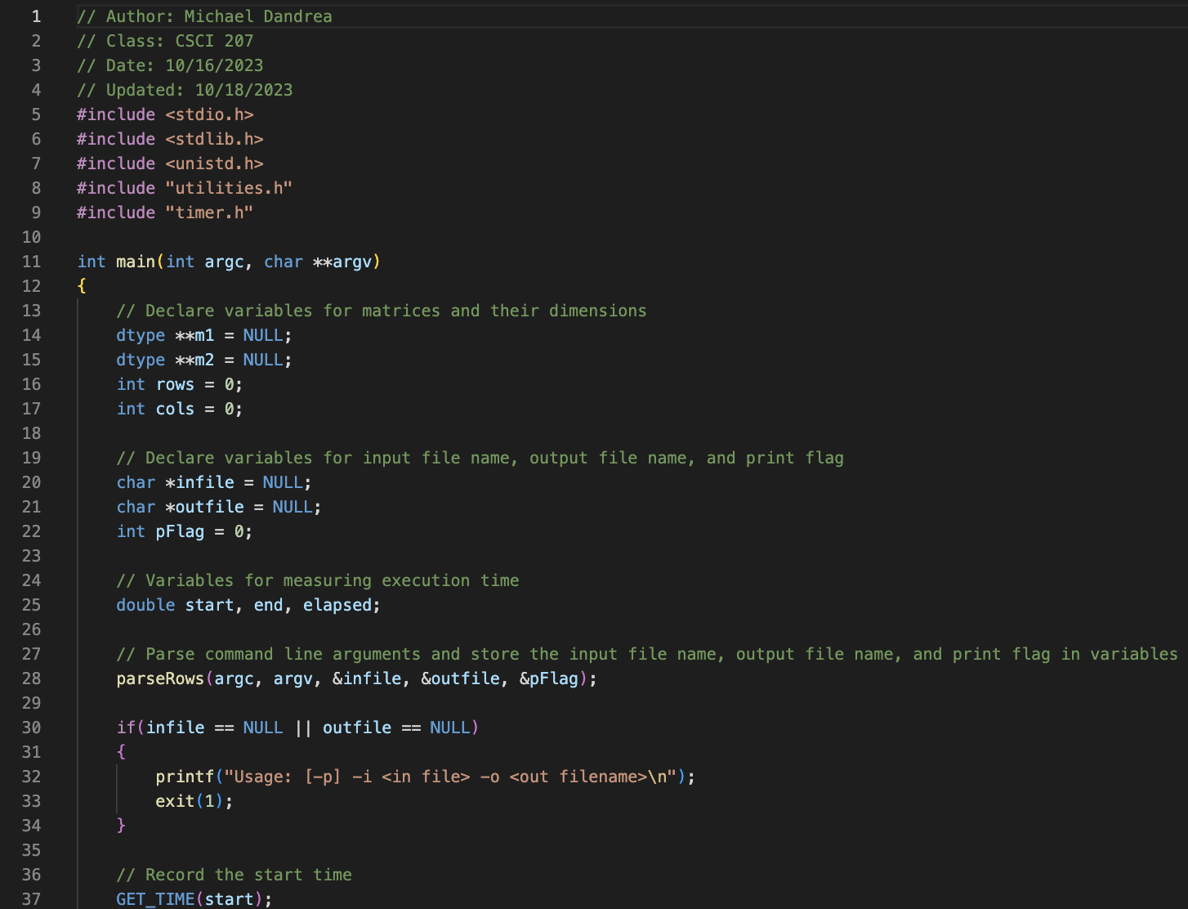
cs_rows_data_2d.c

Slide 10
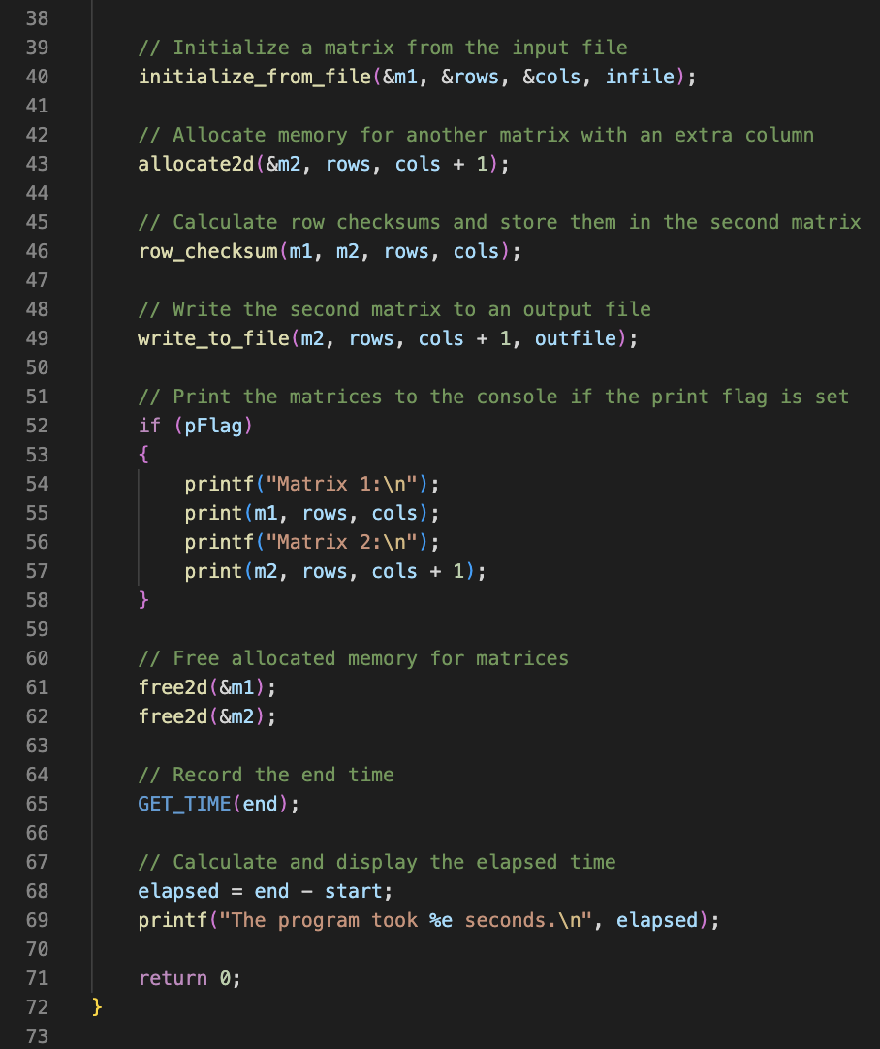
cs_rows_data_2d.c (cont.)

Slide 11
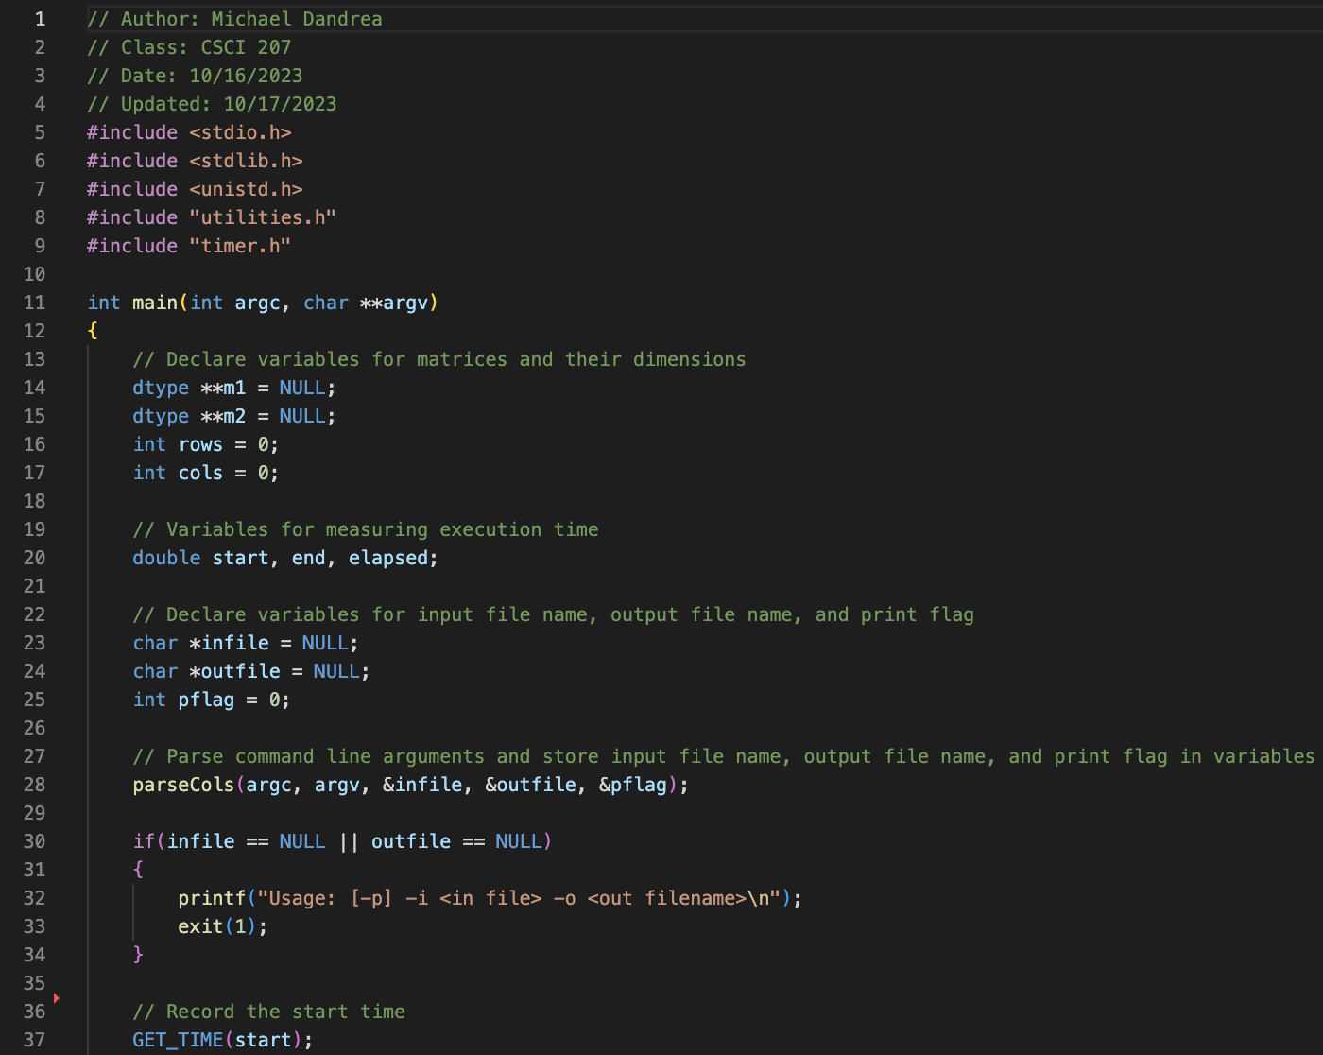
cs_cols_data_2d.c

Slide 12
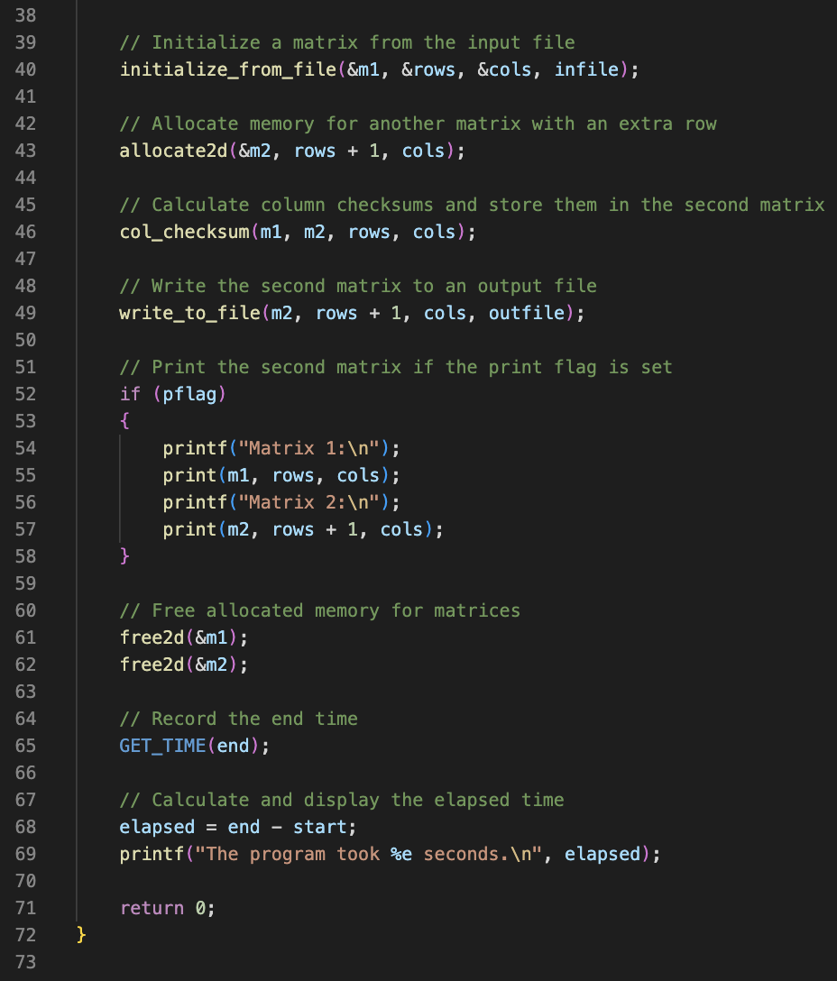
cs_cols_data_2d.c (cont.)

Slide 13
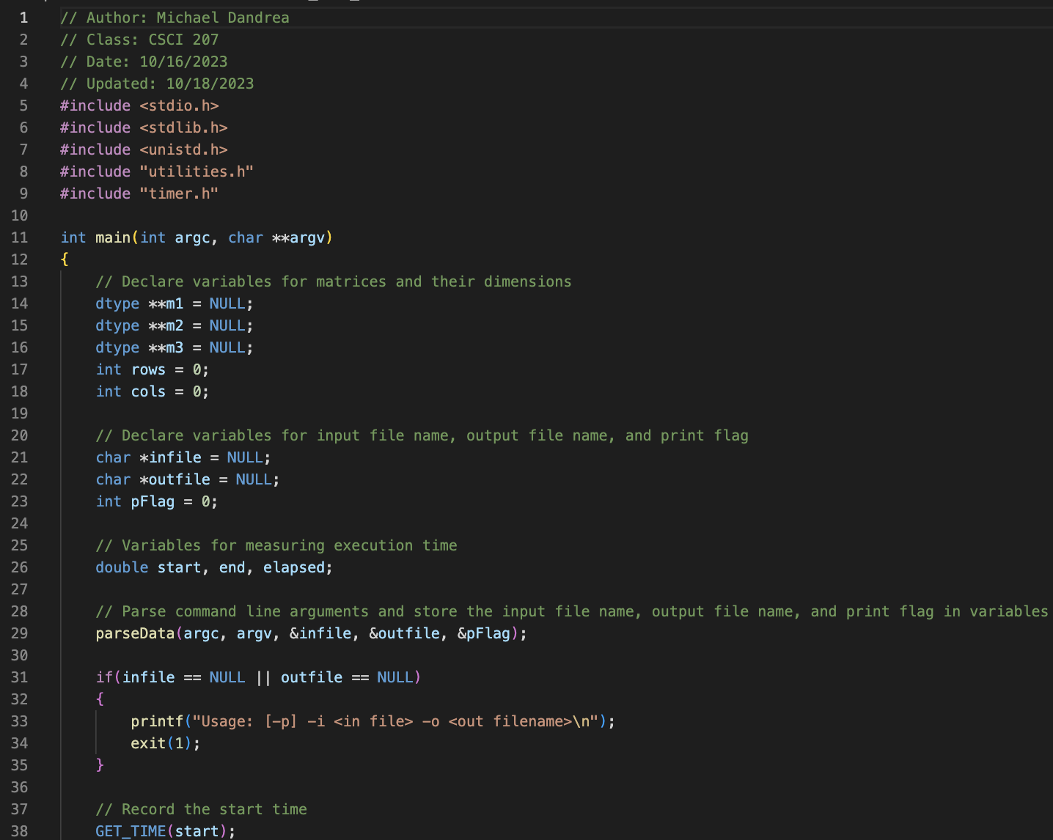
cs_data_2d.c

Slide 14
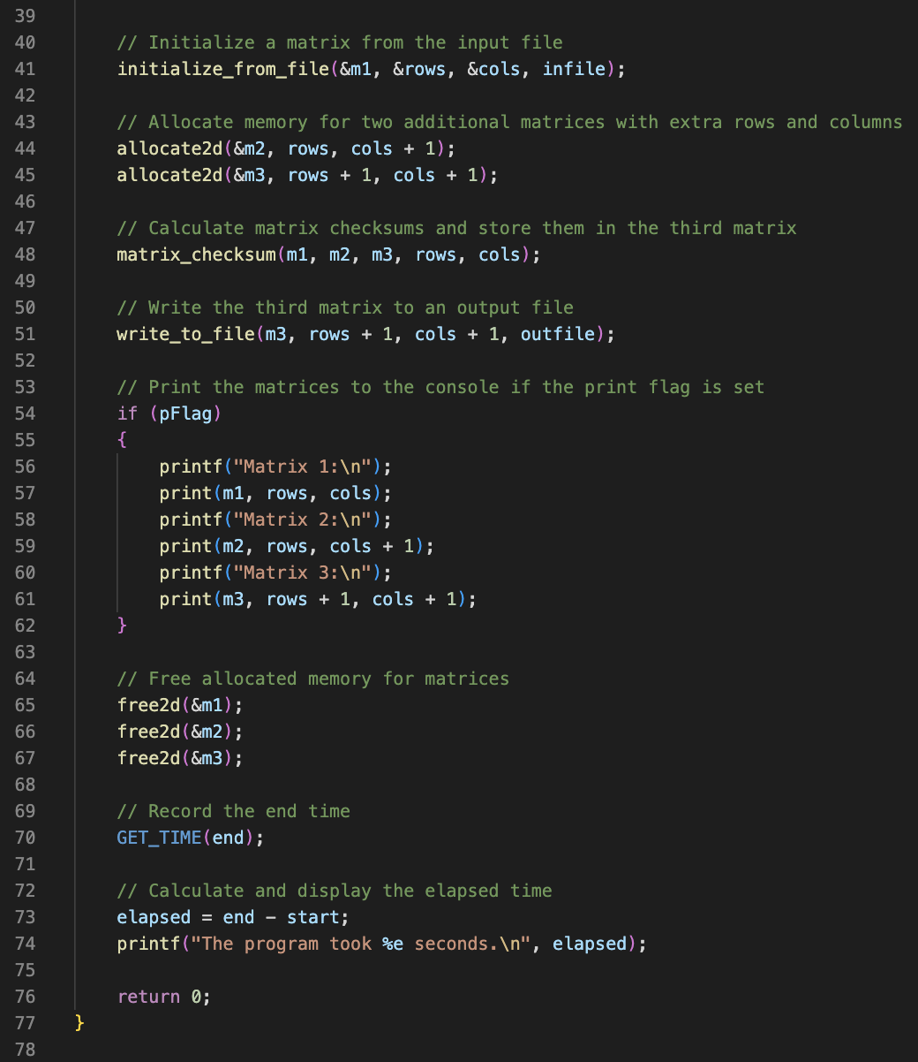
cs_data_2d.c (cont.)

Slide 15
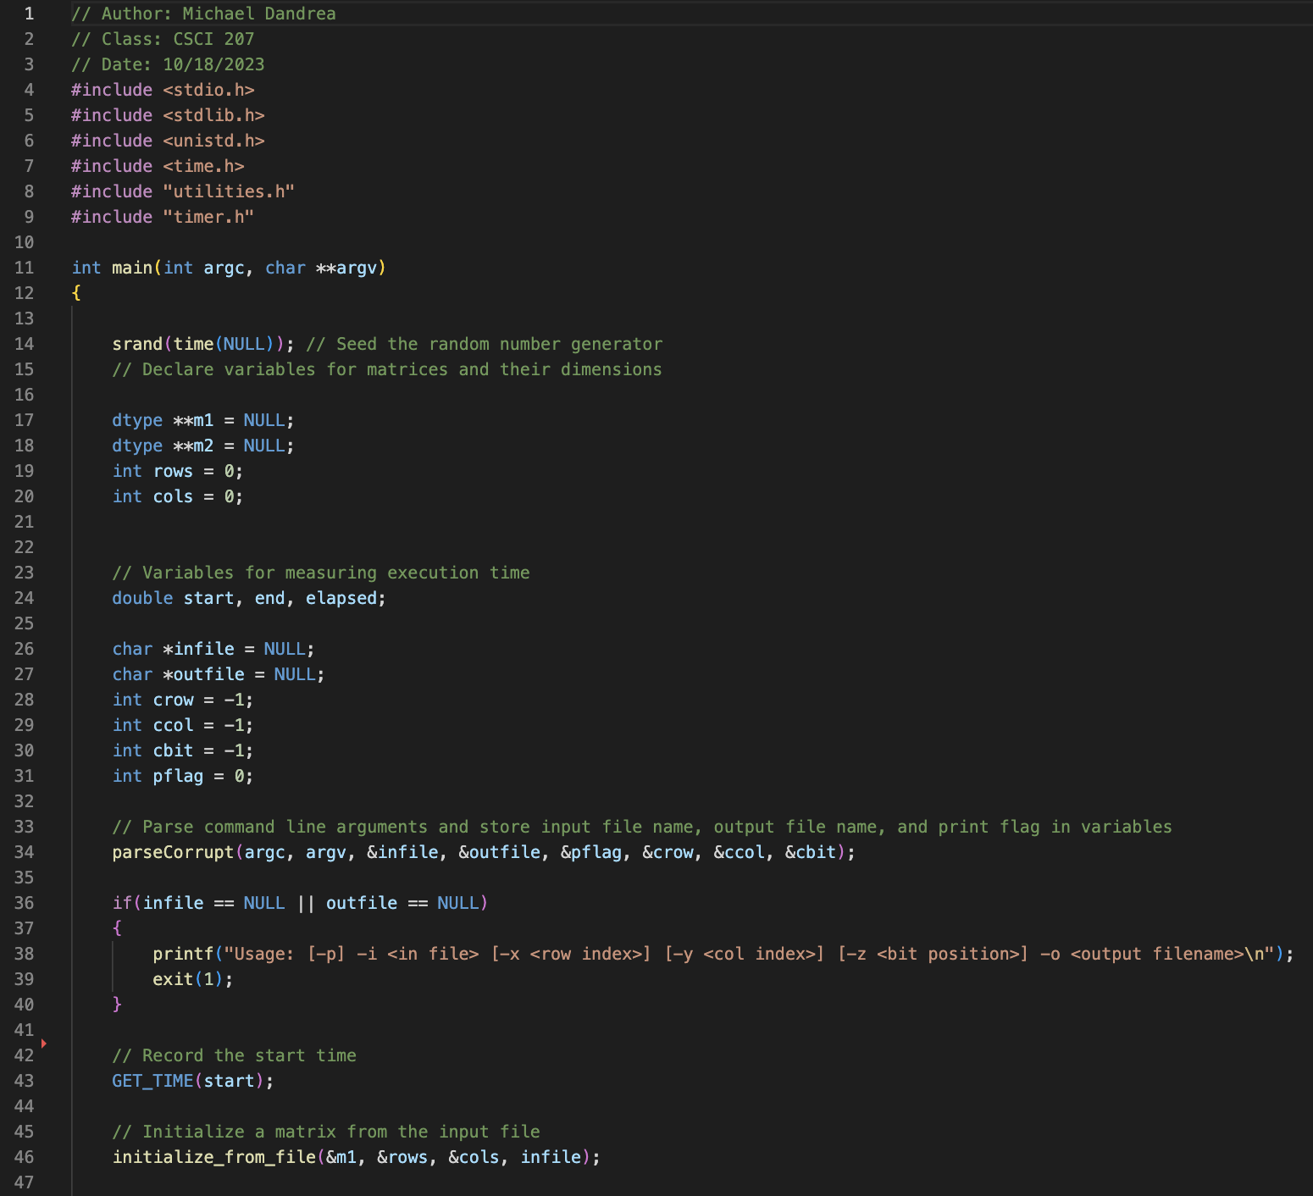
corrupt_data_2d.c

Slide 16
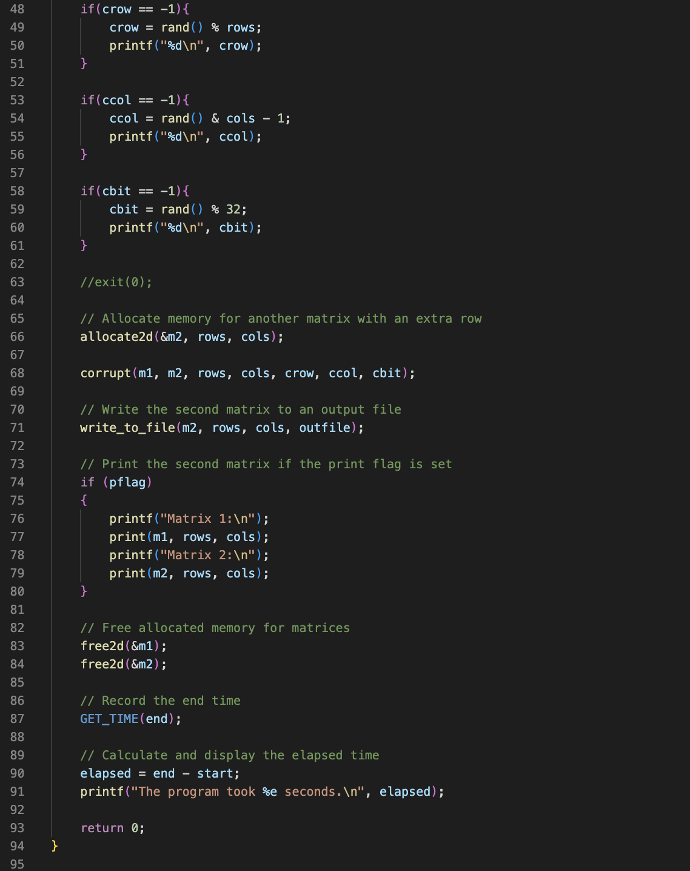
corrupt_data_2d.c (cont.)

Slide 17
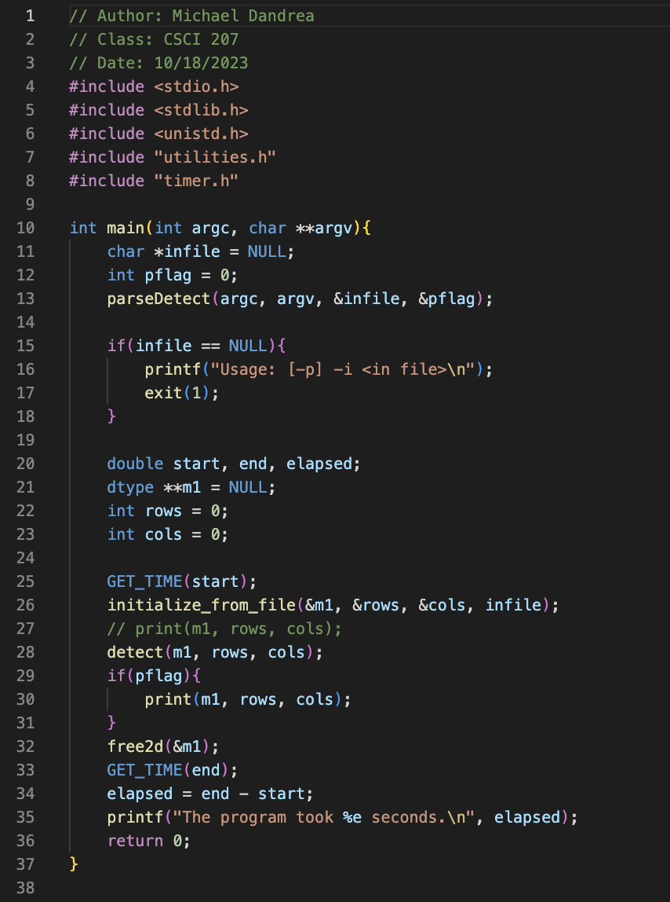
detect_data_2d.c

Slide 18
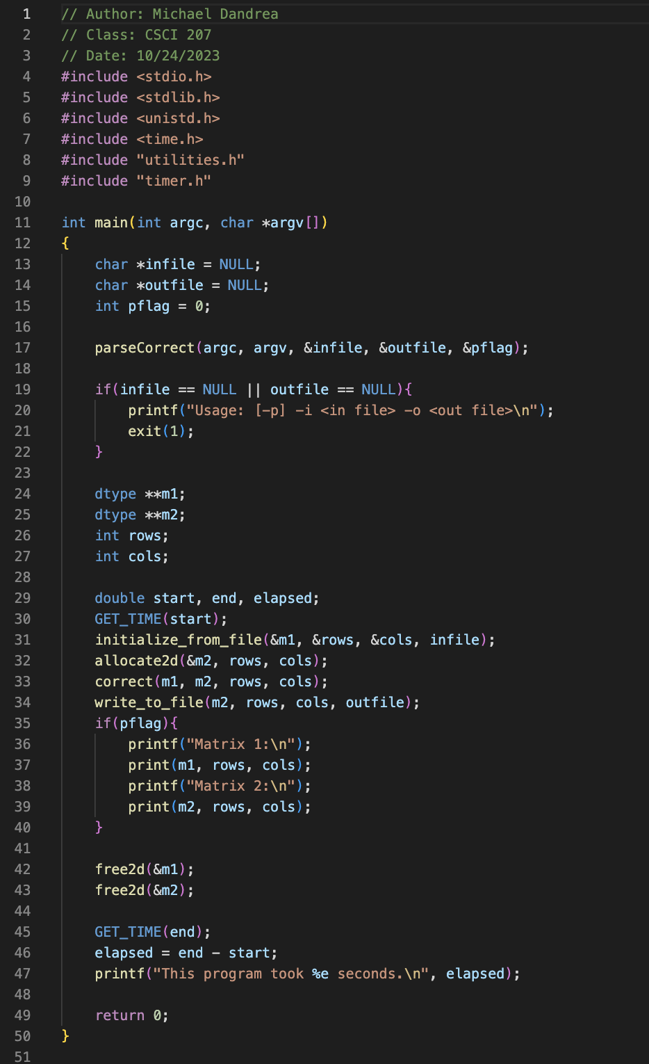
correct_data_2d.c

Slide 19
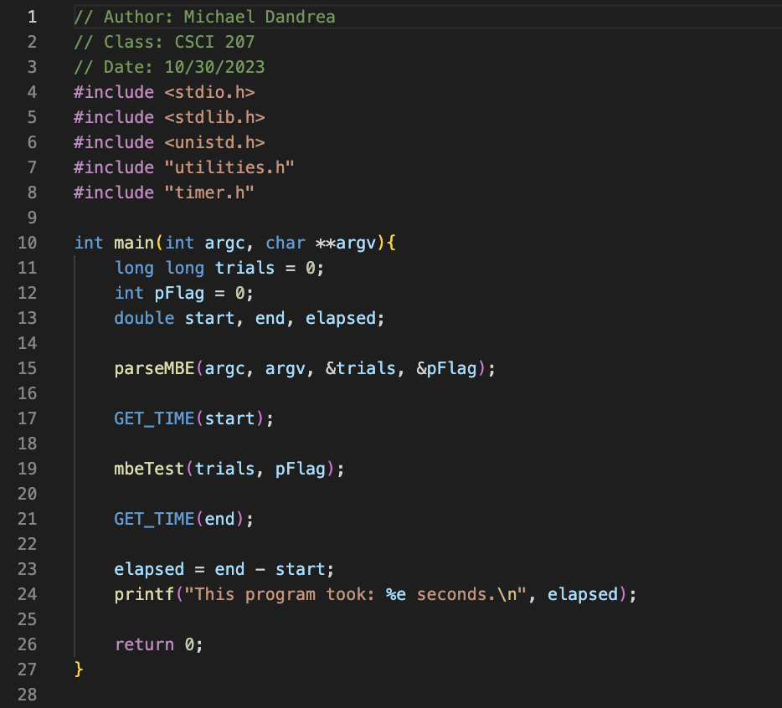
simple_mbe_test.c

Slide 20
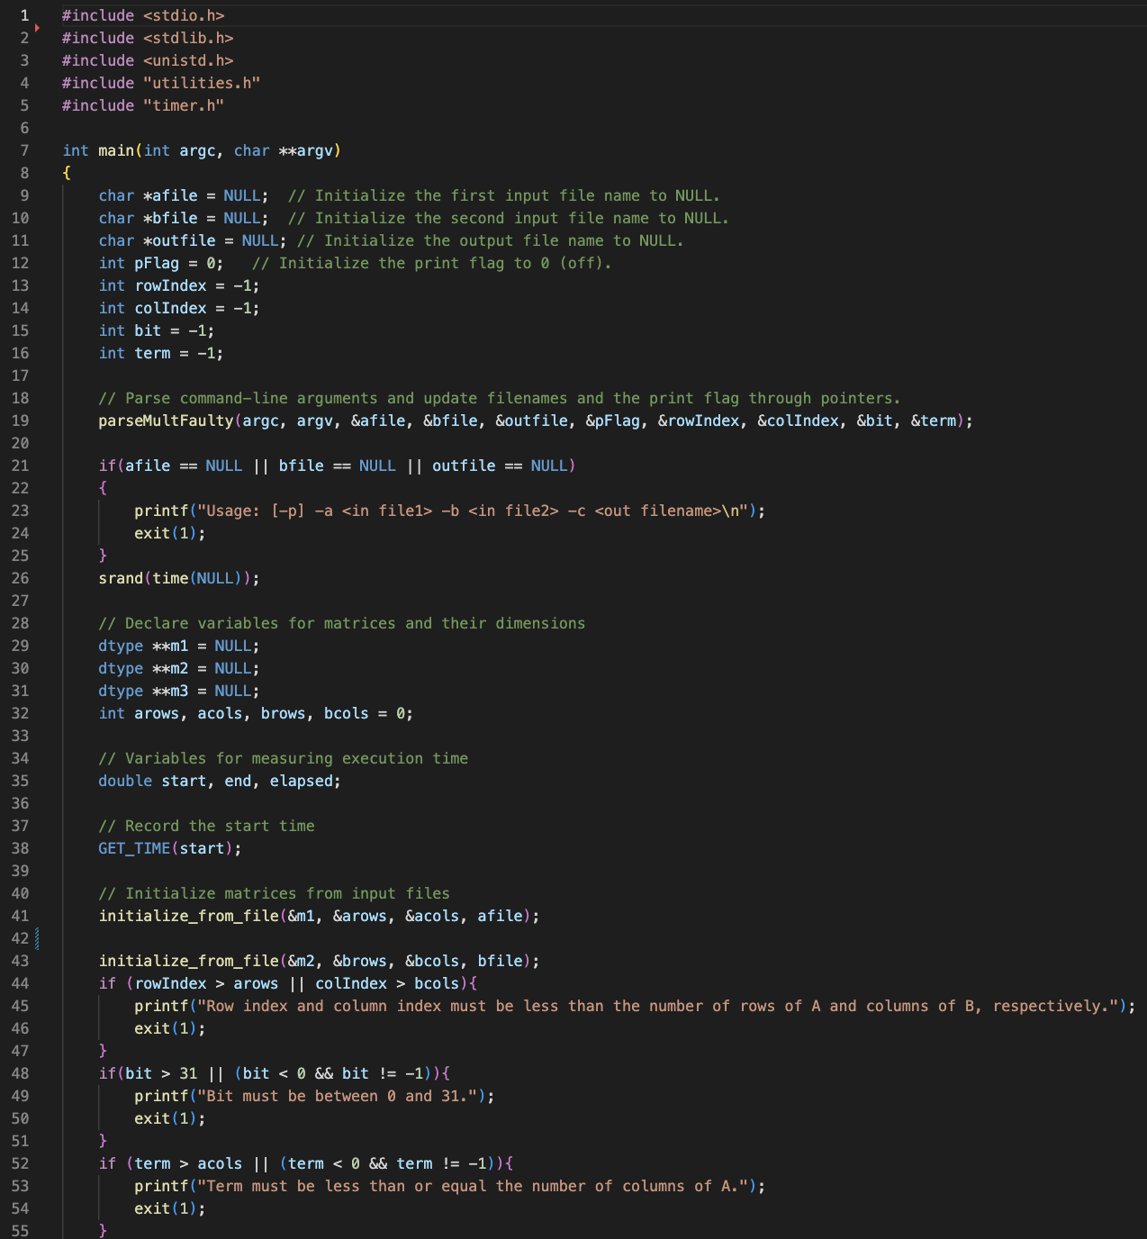
mul_data_2d_faulty.c

Slide 21
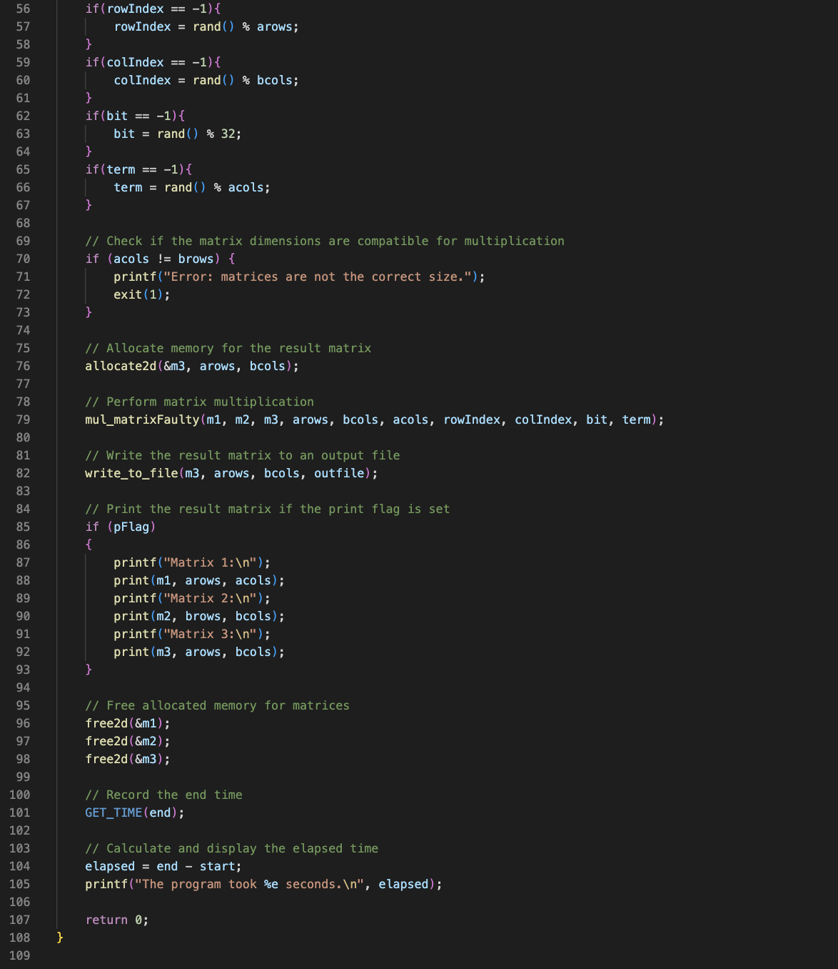
mul_data_2d_faulty.c (cont.)

Slide 22
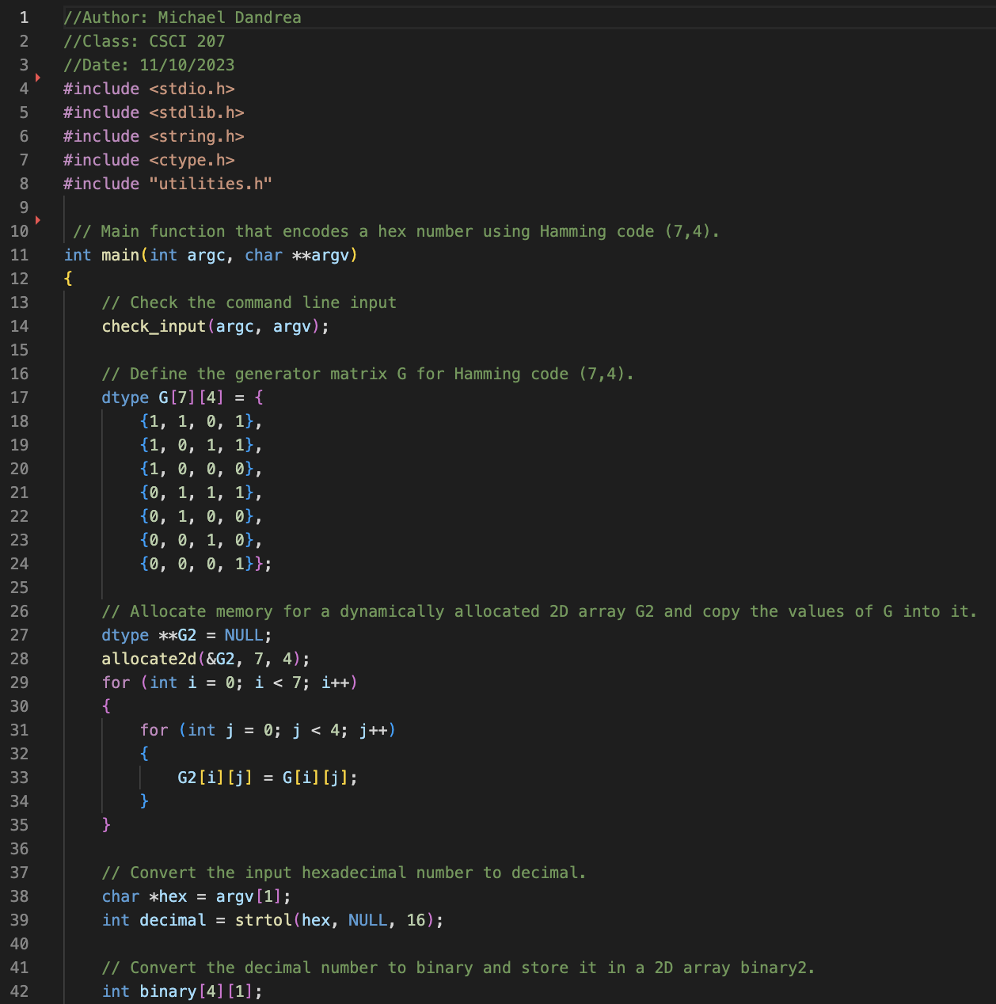
ham-encode-4.c

Slide 23
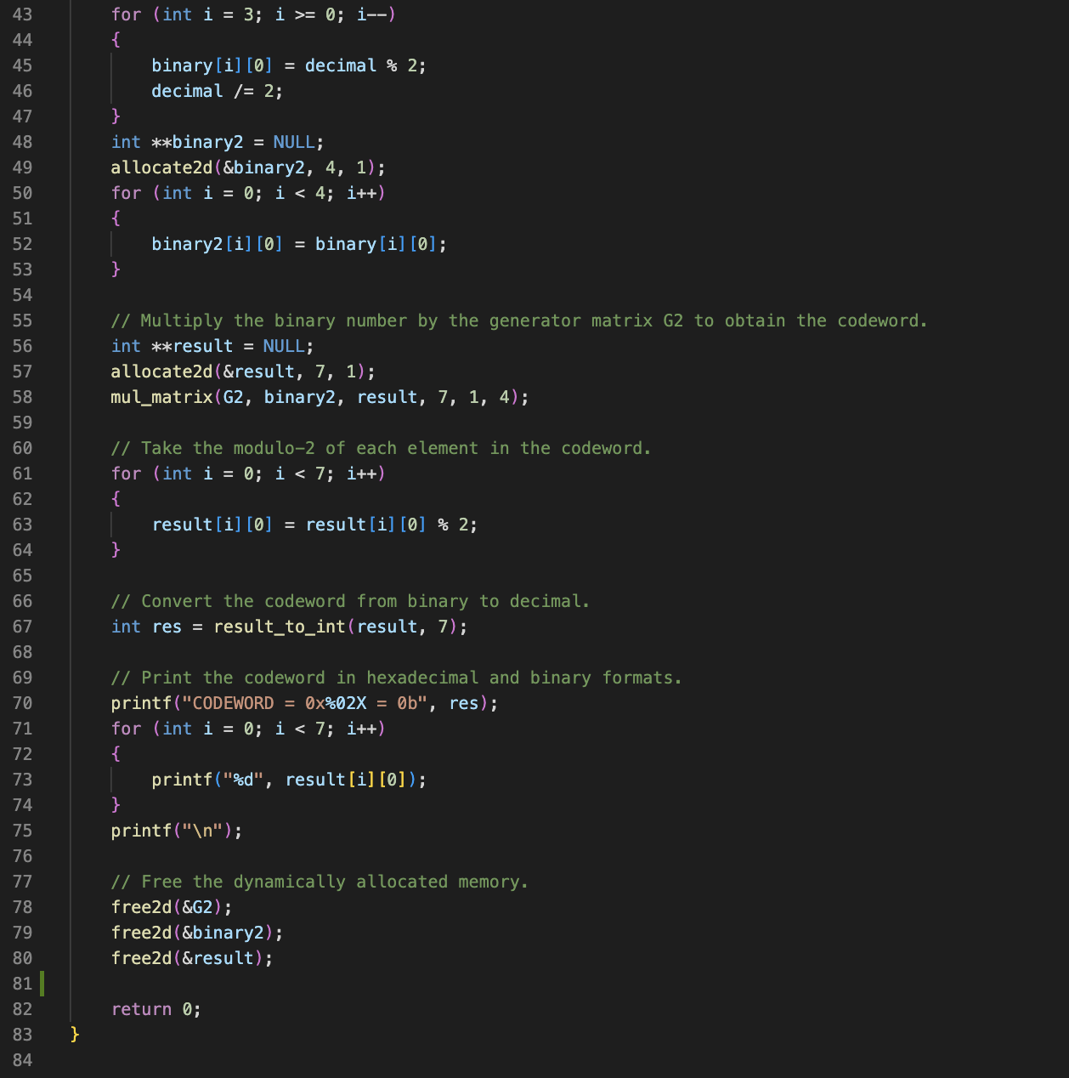
ham-encode-4.c (cont.)

Slide 24
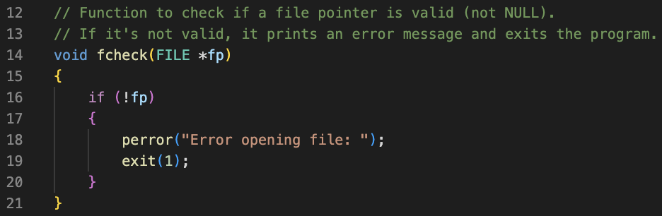
utilities.c:
fcheck

Slide 25
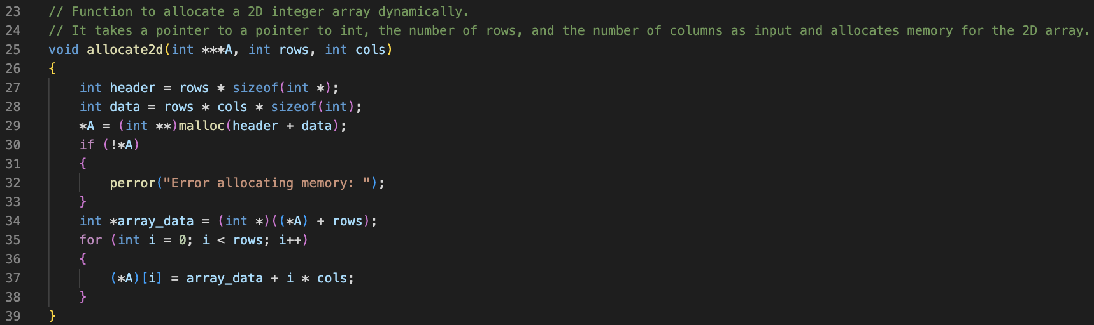
utilities.c:
allocate2d

Slide 26
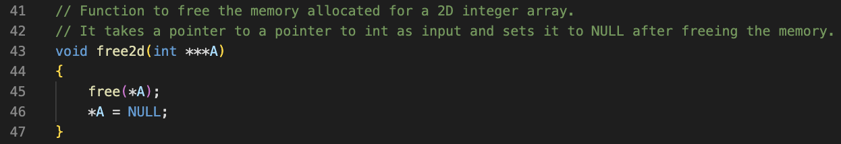
utilities.c: free2d

Slide 27
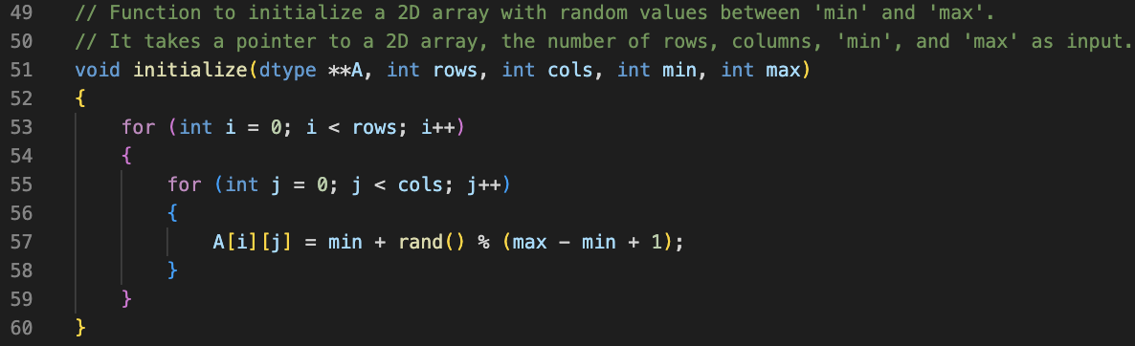
utilities.c:
initialize

Slide 28
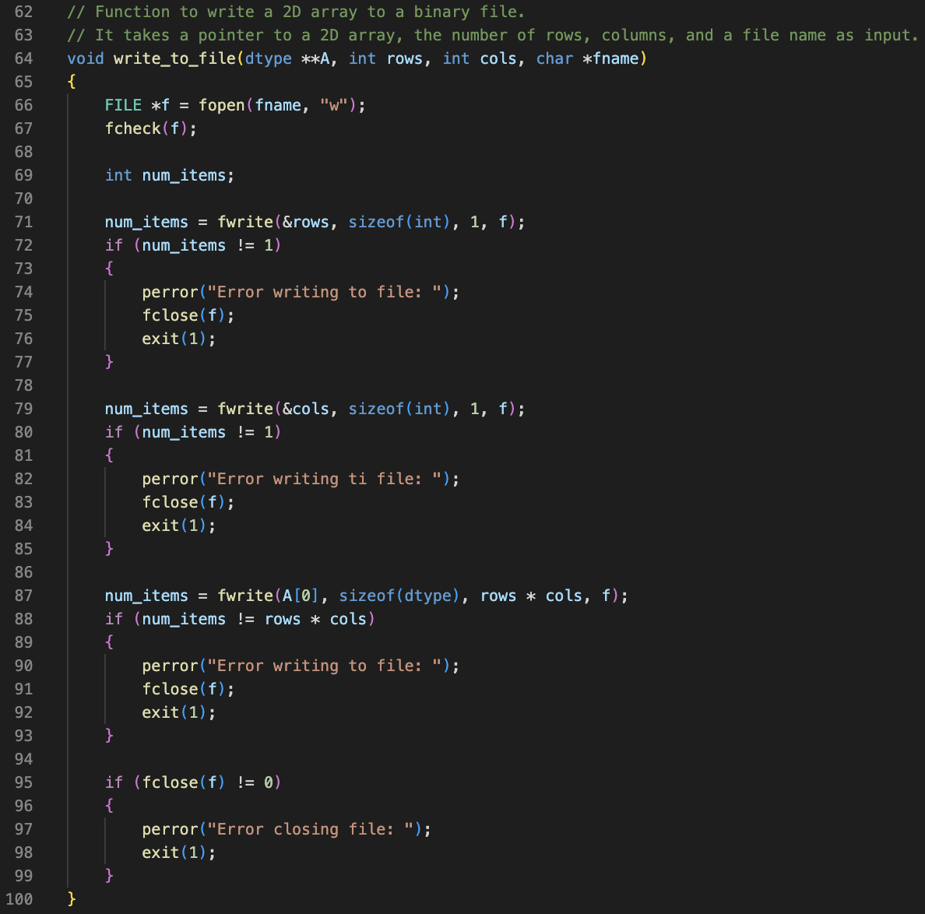
utilities.c:
write_to_file

Slide 29
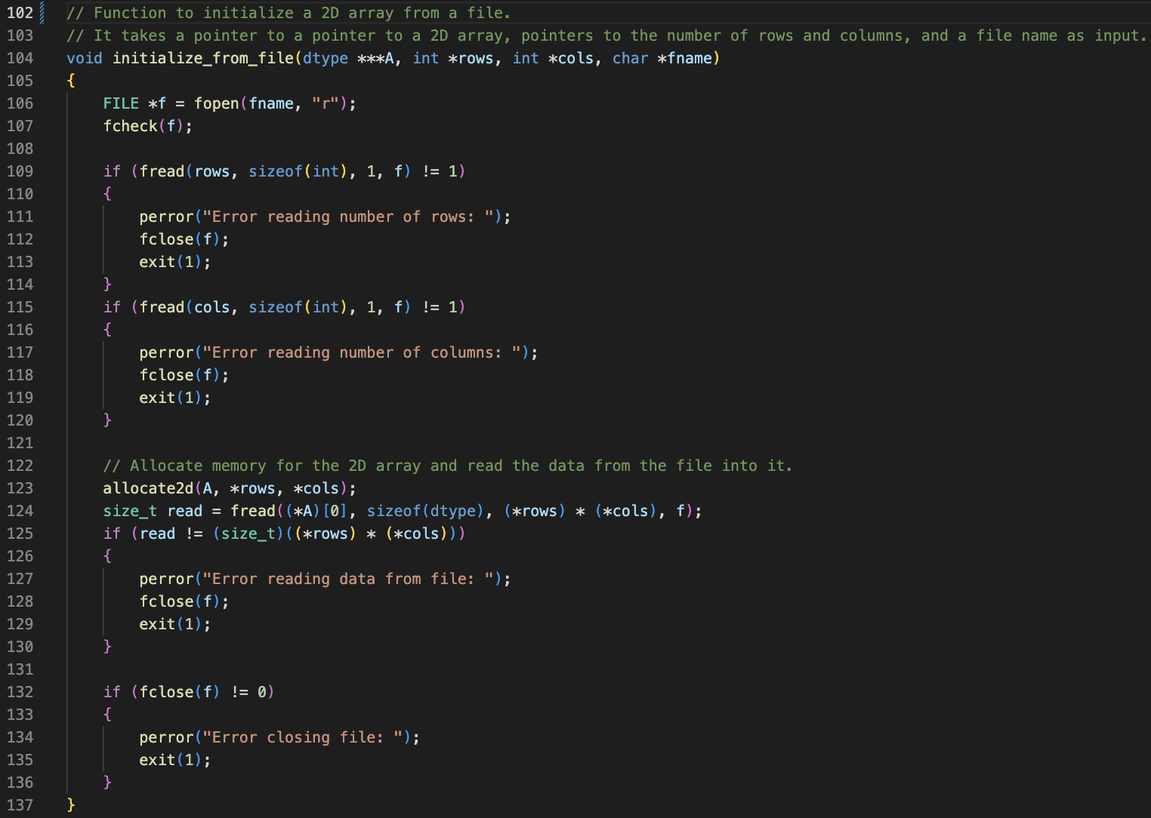
utilities.c:
initialize_from_file

Slide 30
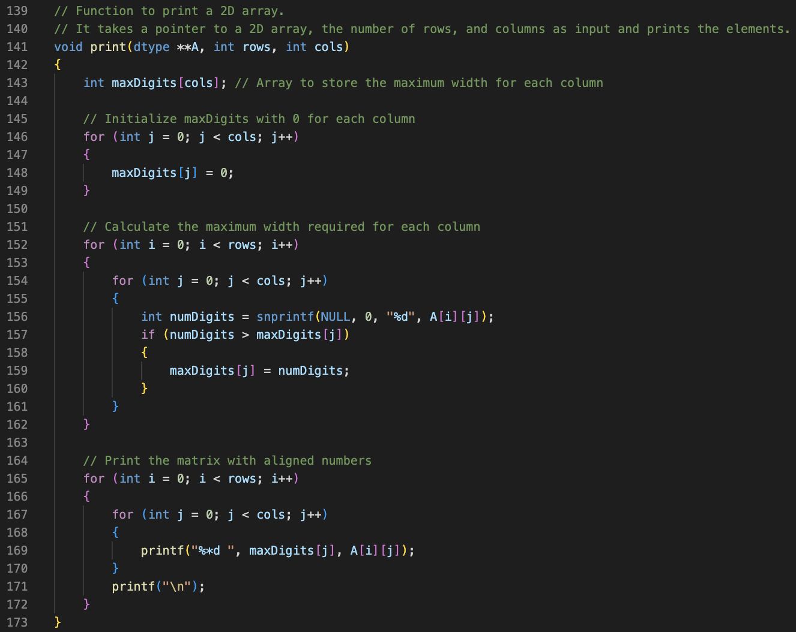
utilities.c:
print

Slide 31
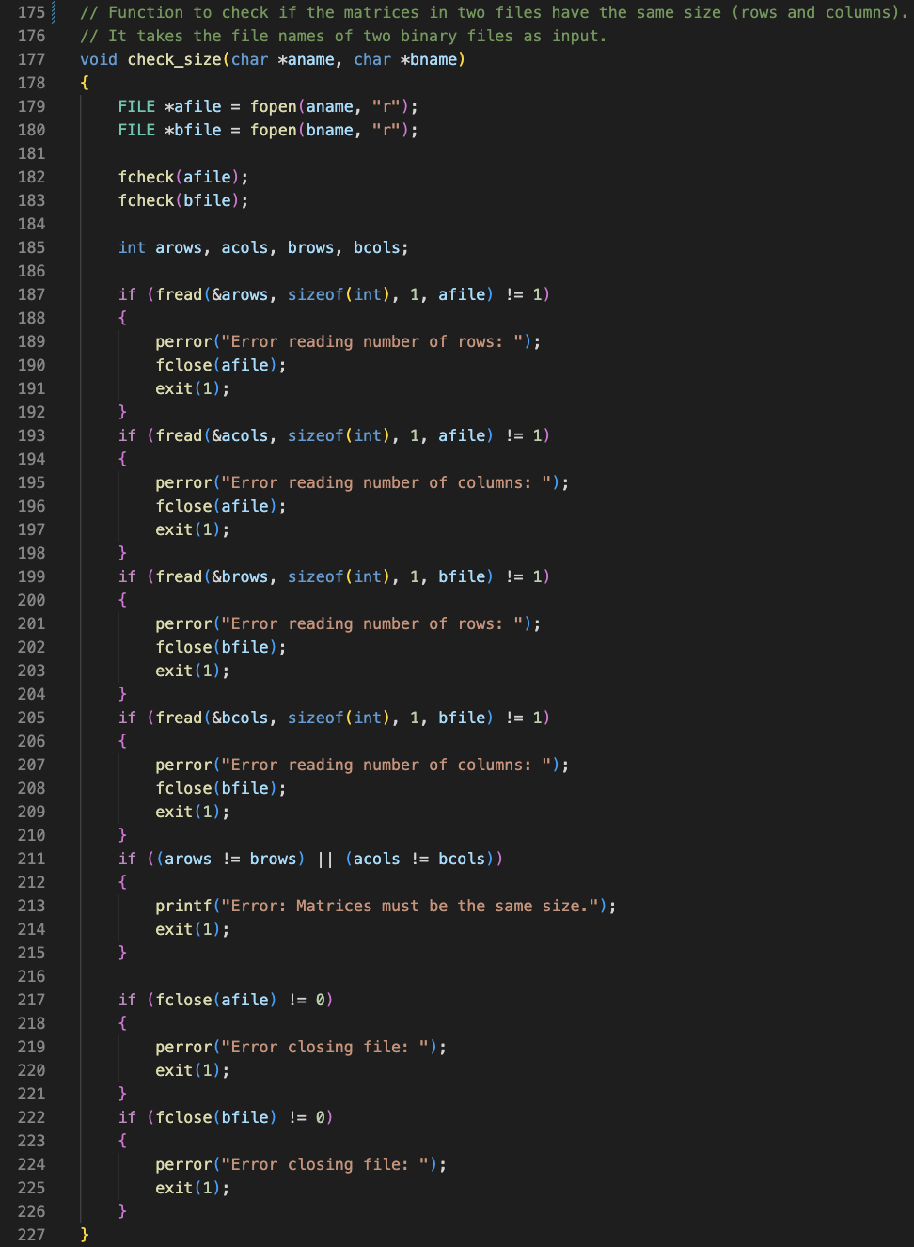
utilities.c:
check_size

Slide 32
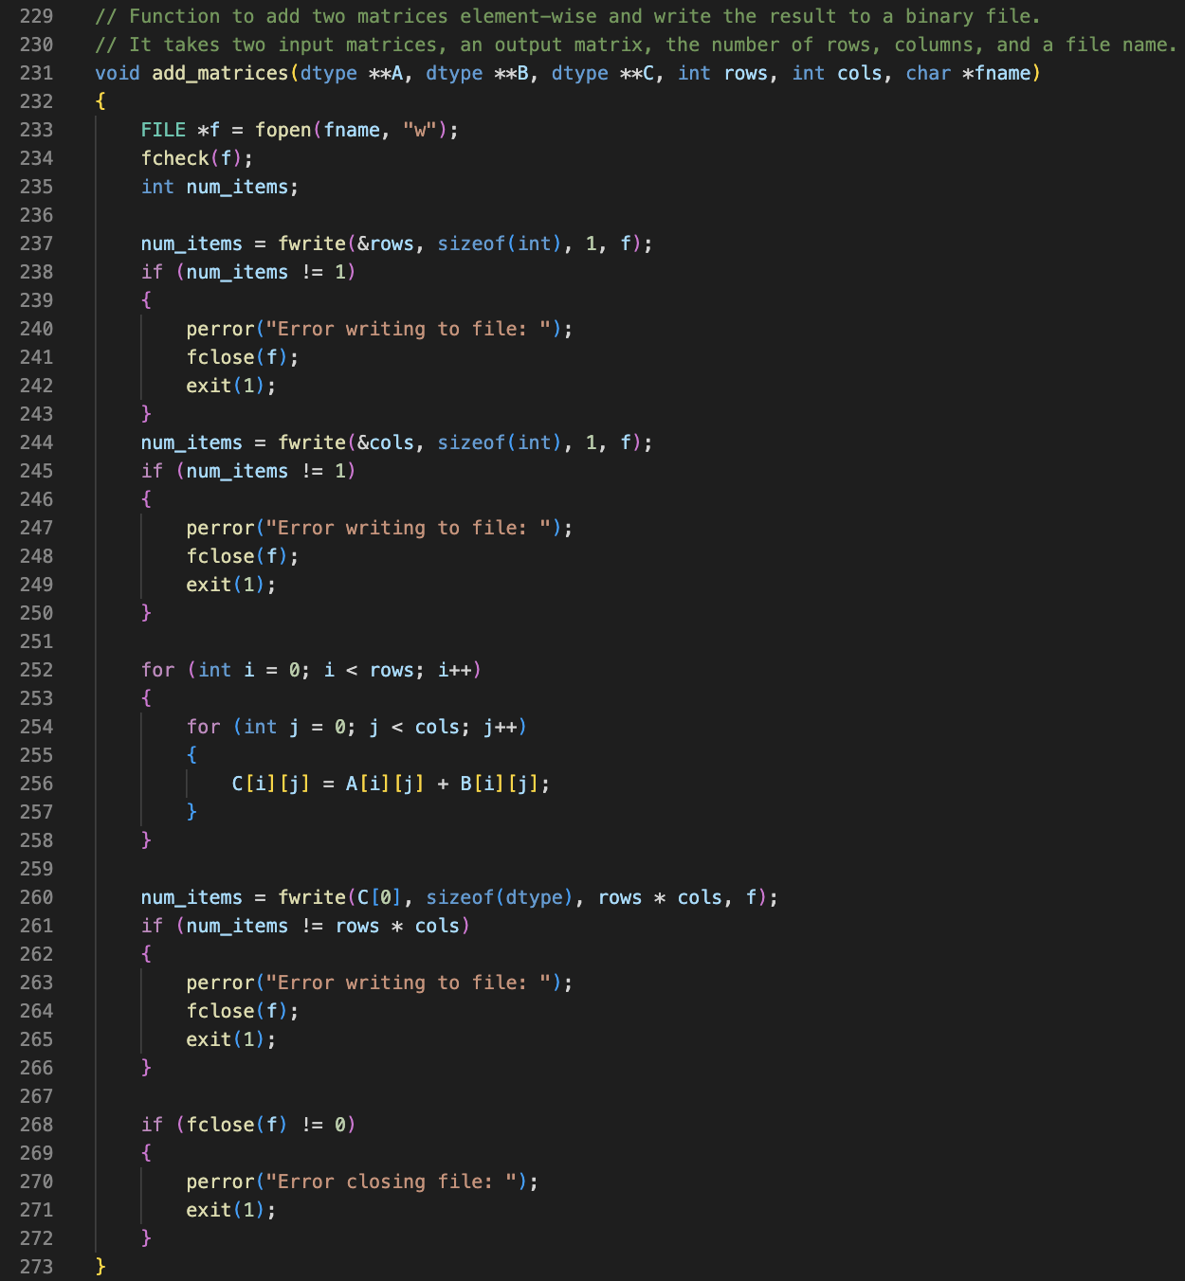
utilities.c:
add_matrices

Slide 33
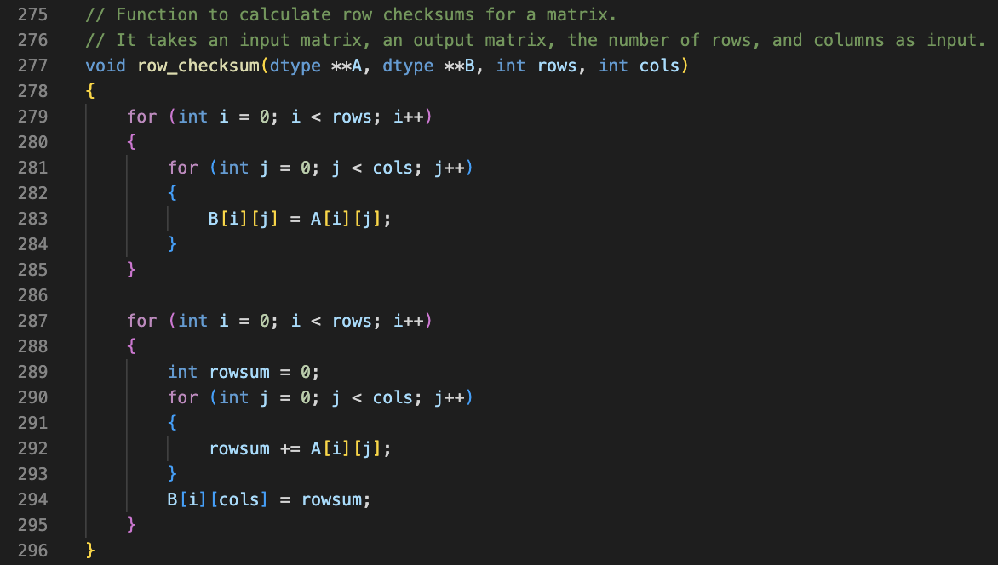
utilities.c: row_checksum

Slide 34
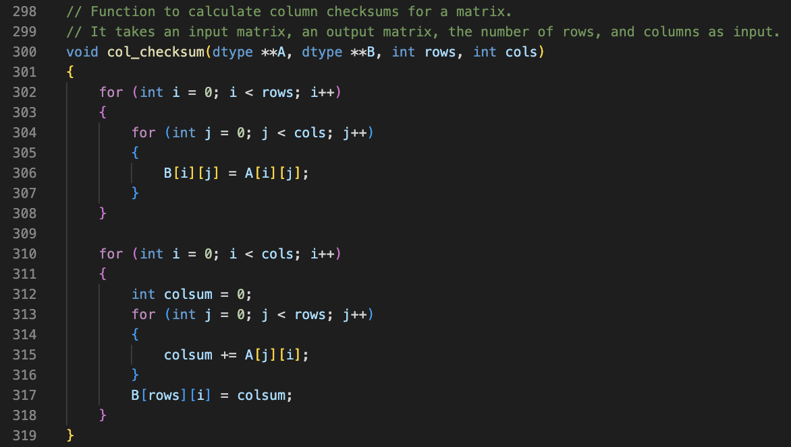
utilities.c: col_checksum

Slide 35
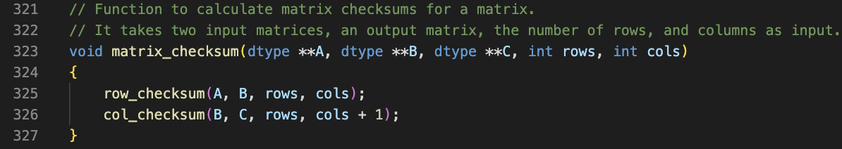
utilities.c:
matrix_checksum

Slide 36
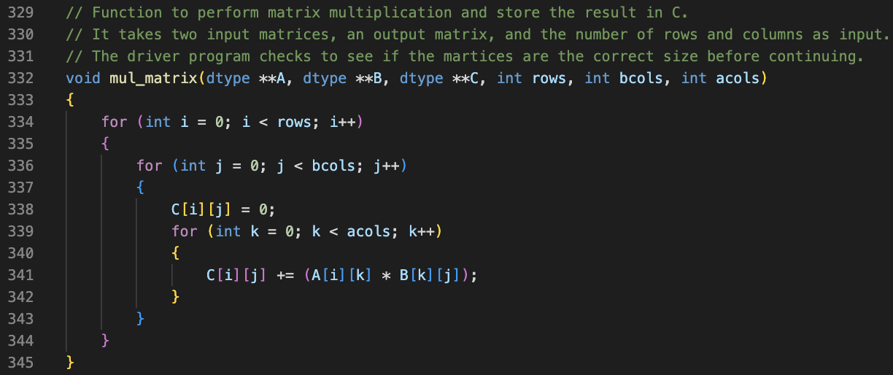
utilities.c:
mul_matrix

Slide 37
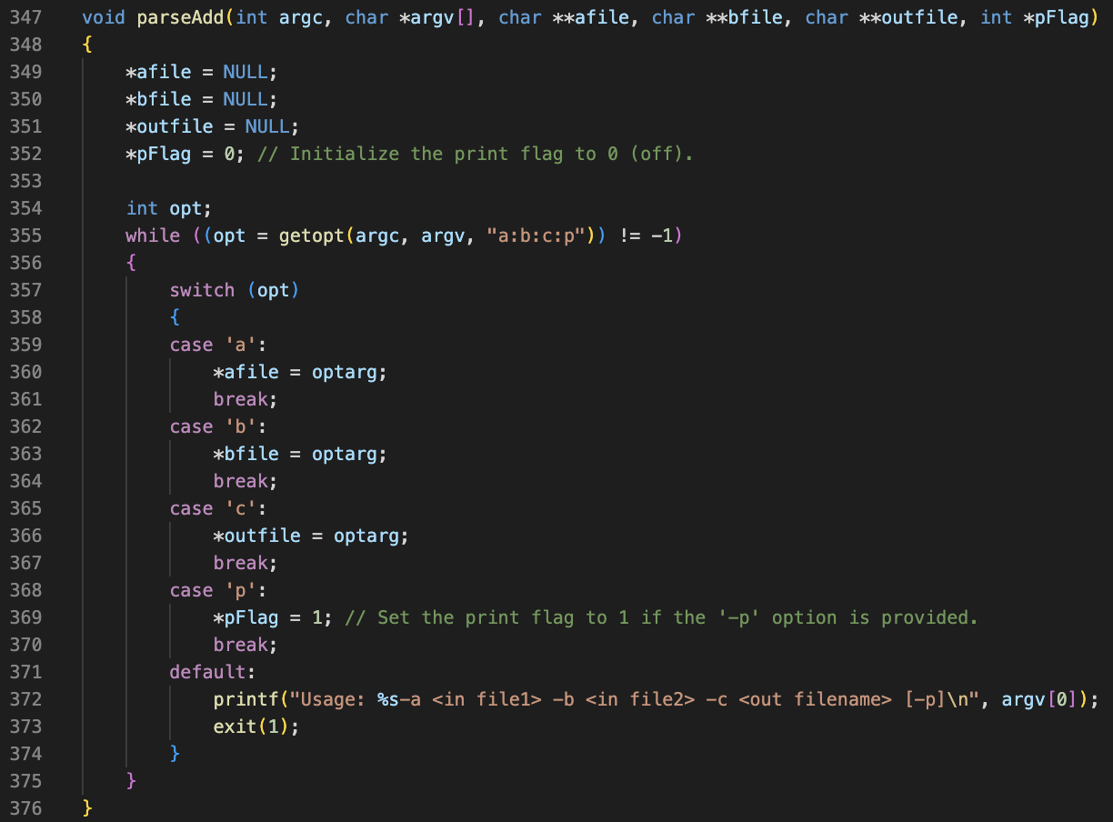
utilities.c:
parseAdd

Slide 38
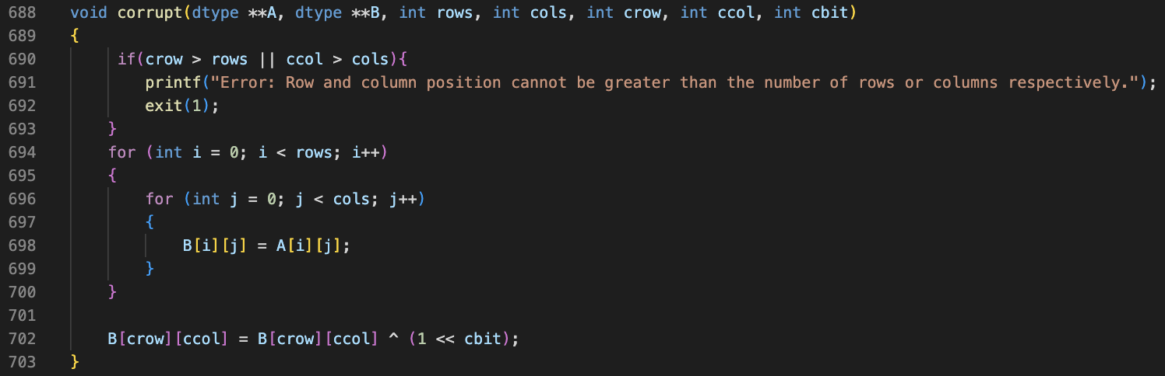
utilities.c:
corrupt

Slide 39
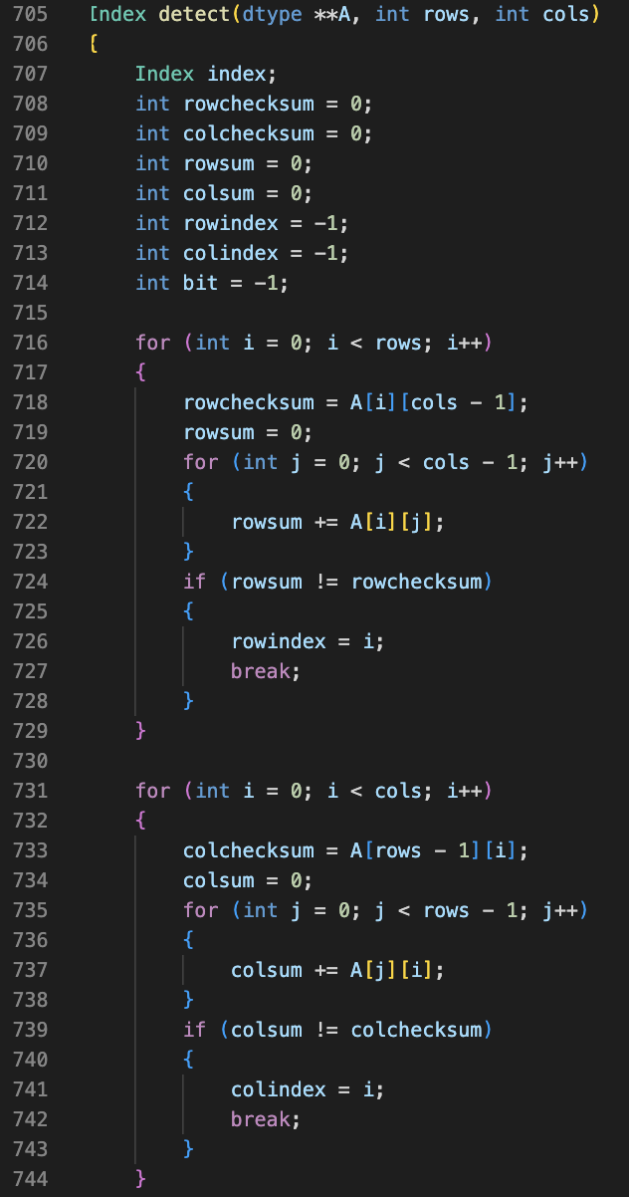
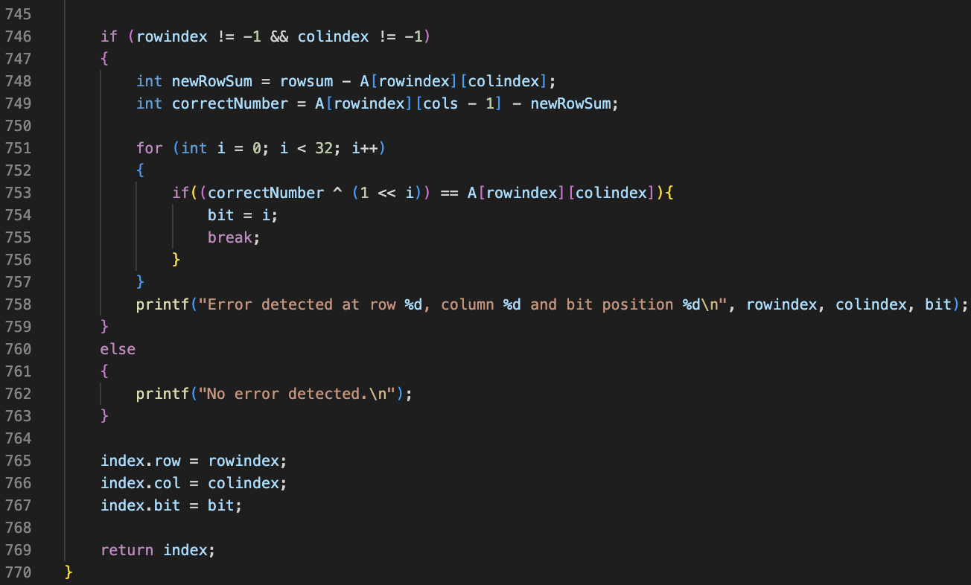
utilities.c:
detect

Slide 40
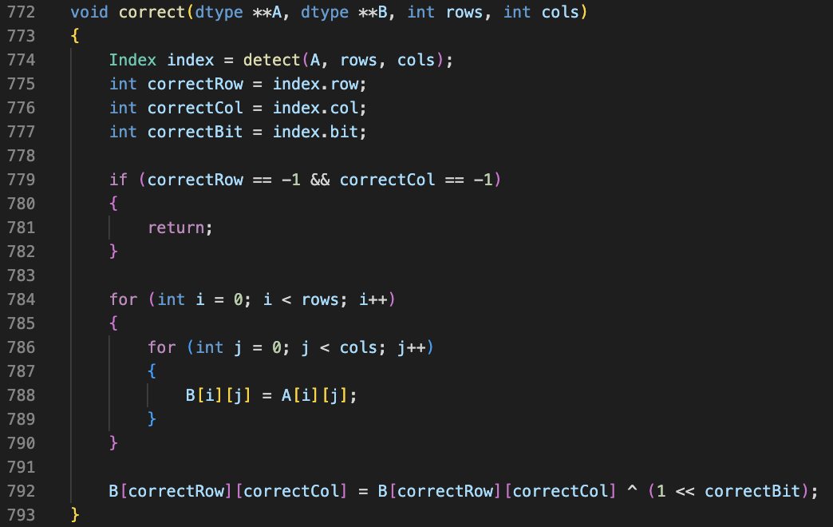
utilities.c:
correct

Slide 41
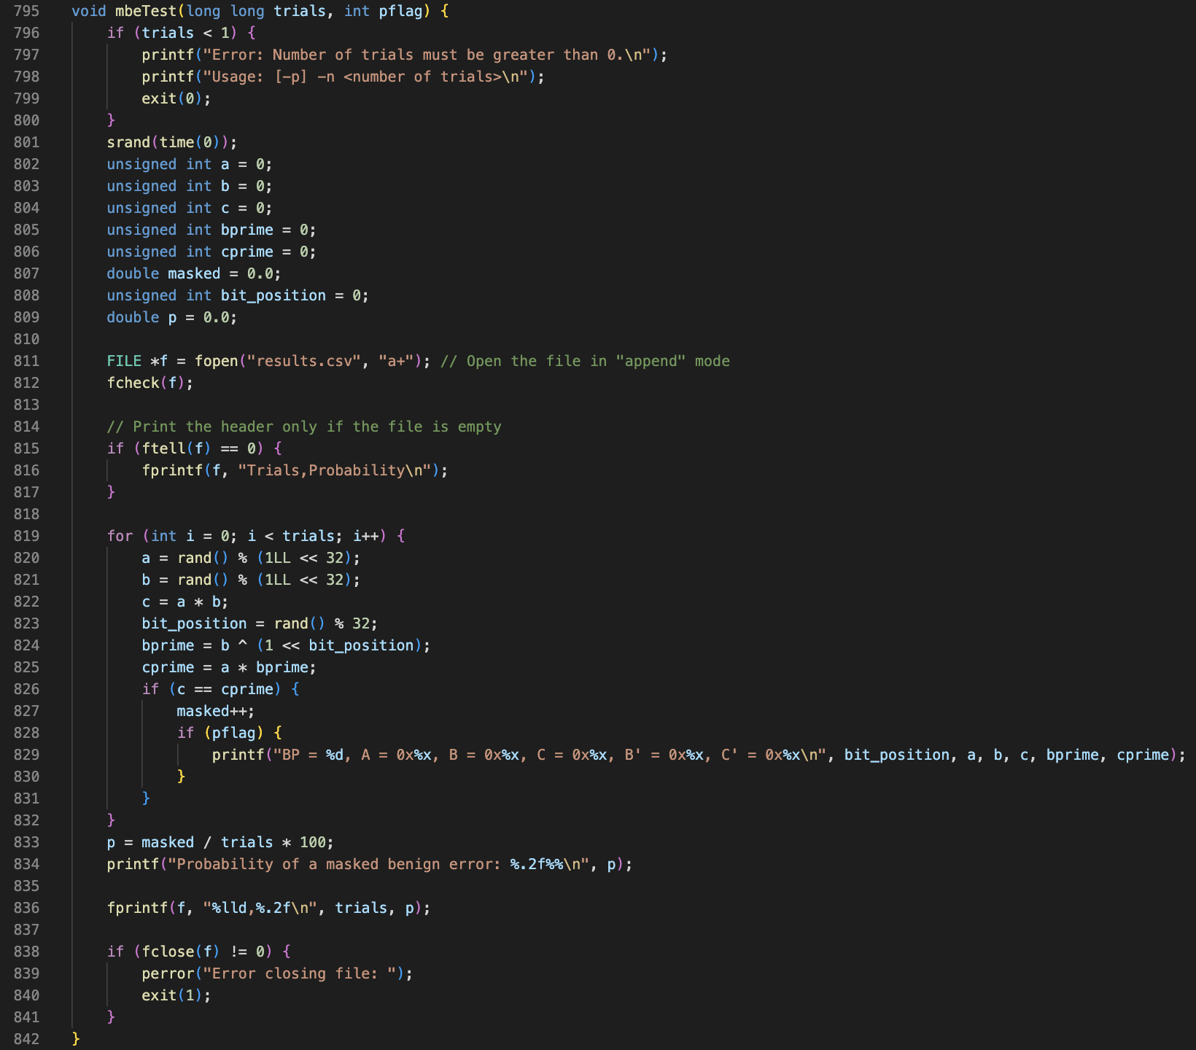
Utilities.c:
mbeTest

Slide 42
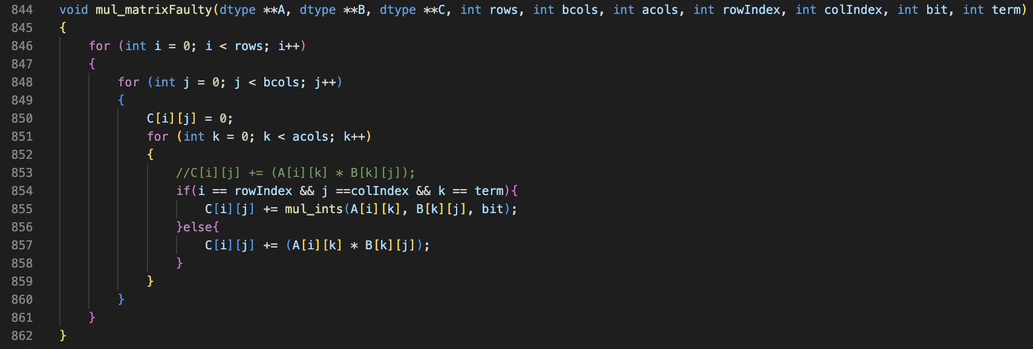
utilities.c:
mul_matrixFaulty

Slide 43
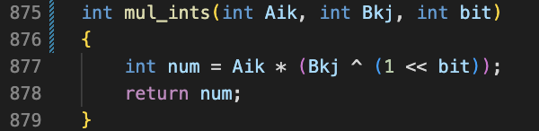
utilities.c:
mul_ints

Slide 44
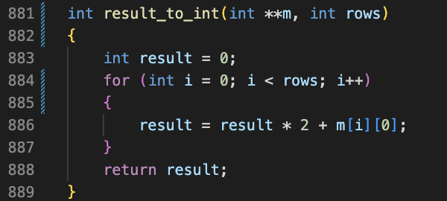
utilities.c:
result_to_int

Slide 45
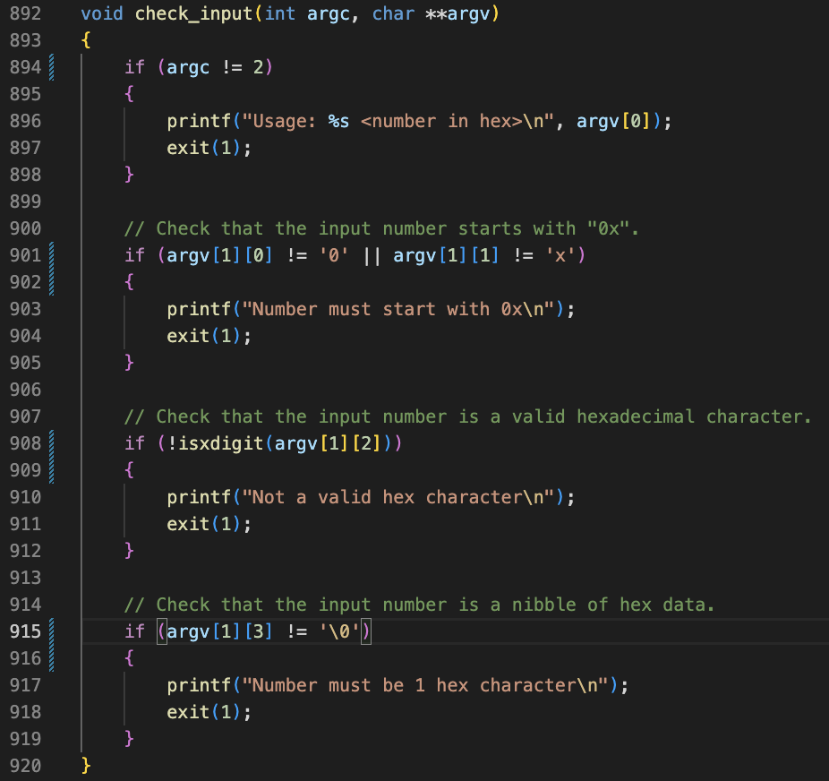
utilities.c:
check_input

Slide 46
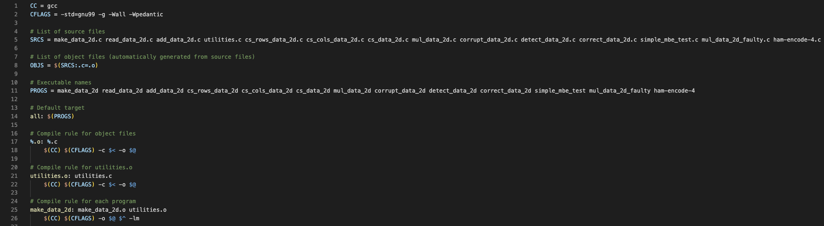
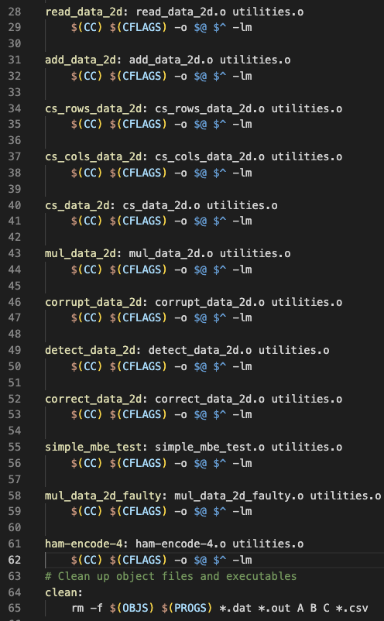
Makefile

